Slide 1
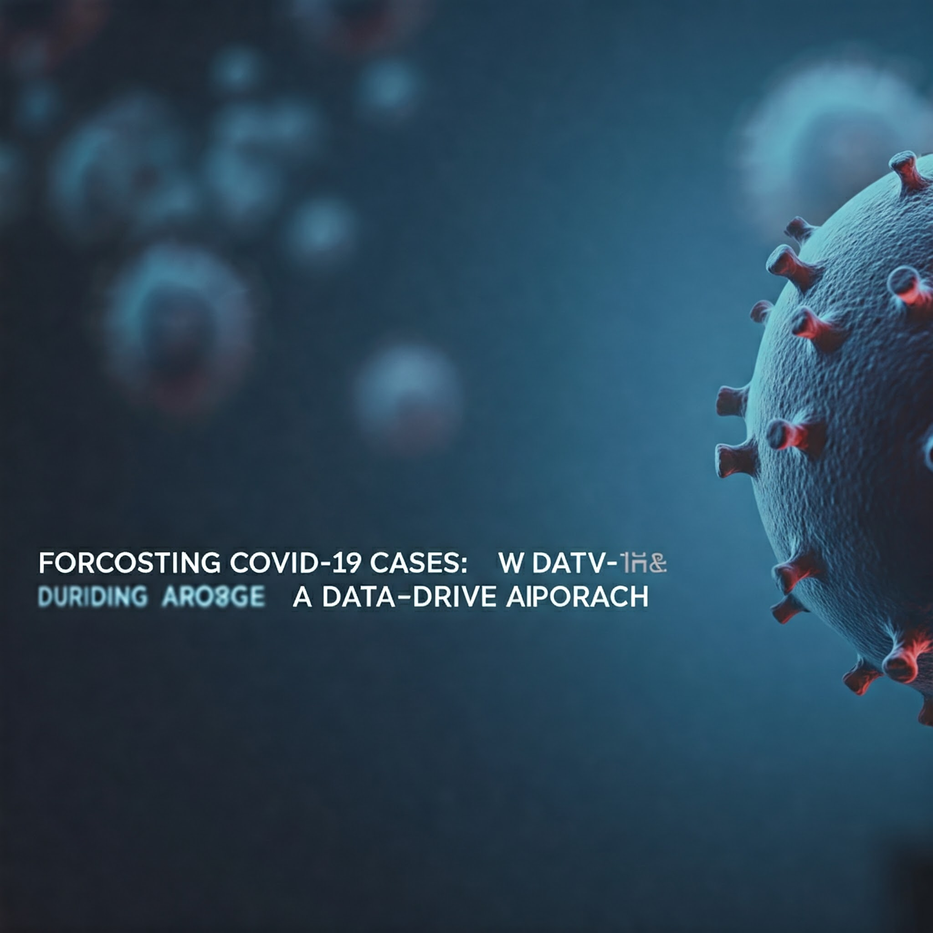

Slide 2
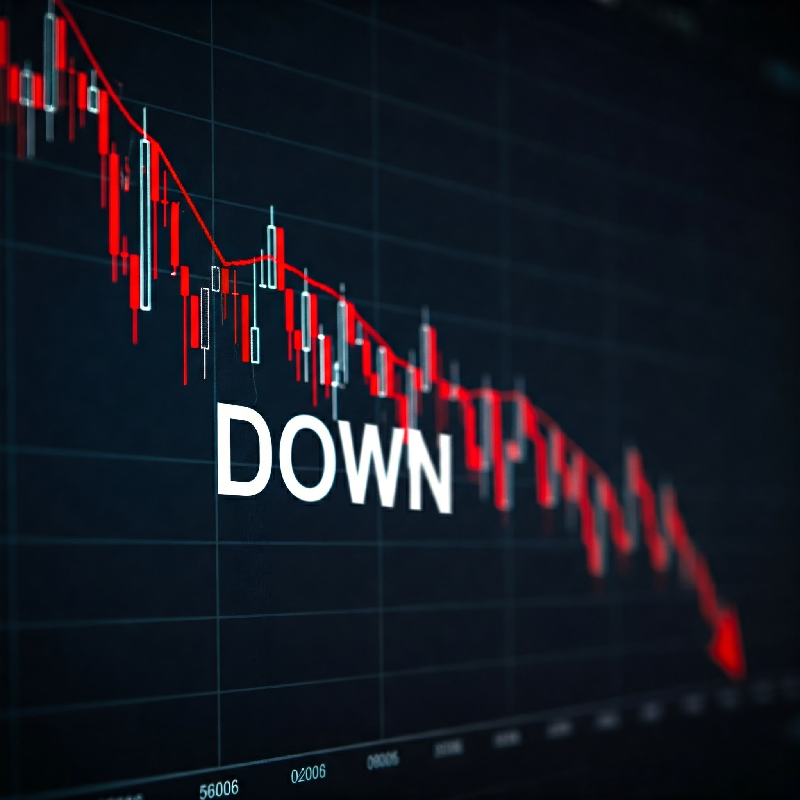
Economic Fallout of COVID-19
Global Recession: Sharp decline in economic activity.
Supply Chain Disruptions: Reduced production and trade.
Job Losses: Increased unemployment rates.
Financial Market Volatility: Uncertainty and instability.
Government Debt: Increased spending on healthcare and relief.

Slide 3

COVID-19: A Global Public Health Crisis
Global Pandemic: Rapid spread, impacting all countries.
Public Health Strain: Overwhelmed healthcare systems, shortages.
Social Impact: Isolation, mental health challenges, inequalities.
Mortality and Morbidity: Millions of deaths, long-term health effects.

Slide 4

Healthcare System Shortcomings During COVID-19
Inadequate Preparedness: Healthcare systems lacked capacity for patient influx.
Inconsistent Messaging: Confusing public health communication.
Porous Containment: Ineffective implementation of control measures.
Training Gaps: Insufficient epidemiological and medical training.
Inadequate Tracking: Lack of proper case tracking systems.
Source: https://www.researchgate.net/publication/362551887_Global_Challenges_to_Public_Health_Care_Systems_during_the_COVID-19_Pandemic_A_Review_of_Pandemic_Measures_and_Problems

Slide 5

Addressing COVID-19 Challenges: Solutions
Early Detection and Surveillance: Implement robust surveillance systems for rapid identification and response.
Healthcare Infrastructure: Invest in healthcare infrastructure and workforce to handle surges.
Public Health Communication: Develop clear, consistent, and culturally-competent communication strategies.
International Collaboration: Foster global cooperation for resource sharing and coordinated response efforts.
Community Engagement: Empower communities to actively participate in prevention and response efforts.

Slide 6

Predictive Modeling: A Double-Edged Sword for Surveillance
Predictive Modeling: Enables forecasting of COVID-19 trends for proactive response.
Benefits: Early detection, resource optimization, targeted interventions.
Potential Downfalls: Data quality limitations, model accuracy, ethical considerations.

Slide 7

Project Objectives: EDA and Predictive Modeling
Analyze COVID-19 data to understand trends.
Perform exploratory data analysis (EDA).
Build predictive models for confirmed cases.
Develop models to predict future confirmed cases.
Impact: Provide actionable insights to inform public health policies, resource allocation, and outbreak preparedness.

Slide 8

Process and Workflow
Data Collection: COVID-19 dataset from Kaggle, supplemented with population data.
Data Cleaning: Date conversion, missing value imputation, feature engineering.
EDA: Visualizations (heatmaps, scatter plots, line plots) to understand trends and distributions.
Preprocessing: Dropped redundant columns, scaled features, split data (training, validation, testing).
Model Building: Linear Regression and Naive Moving Average (baseline).
Evaluation: High RMSE and low R^2 for Linear Regression. NMA struggled to generalize.

Slide 9

Areas for Improvement
Data Quality: Address missing values and outliers.
Feature Engineering: Add lag features and exogenous variables.
Model Selection: Explore ARIMA, Gradient Boosting, and LSTM models.
Evaluation Metrics: Include RMSE and MAPE for comprehensive assessment.
Data Splitting: Ensure strict temporal separation in train-test splits.

Slide 10

Conclusion.
The COVID-19 was a major blow on the global economy and health systems, it revealed issues with modern public health, but was an opportunity in disguise for improvement and prevention in was such area as surveillance of future cases, hence the COVID-19 Forecast Model. The Model performance was limited by dataset complexity and modeling approach. Feature engineering, incorporating additional variables, further hyperparameter tunning, and more robust models are necessary for improvement.

